Slide 1

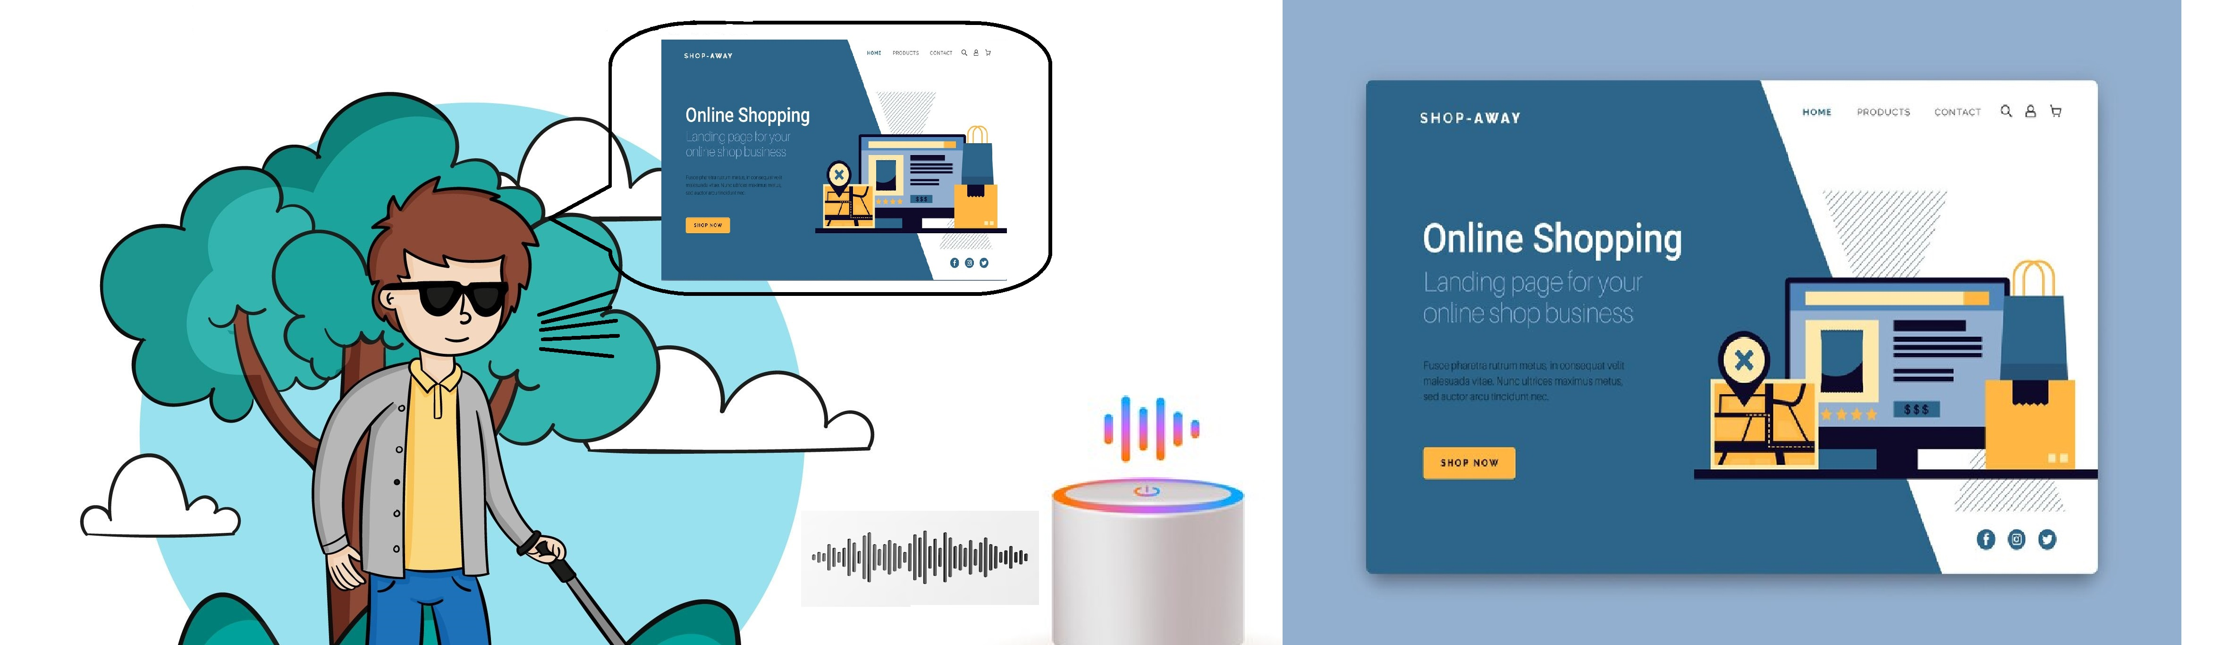
Screen Interpreting Assistant(SIA)

Slide 2


Major Project
Guide:
Mr. Ch Satish Kumar,
Asst. Professor, CSE Dept,
RGUKT-Srikakulam.
Team Members:
G. Uday Sankar(S180443)
Team number : 29

Slide 3


Abstract
Websites have huge and valuable amounts of information in a transactional format. Developing websites which are accessible to all the users has become a priority. Thus, everyone can use the internet and experience their true potential. Despite visually elegant websites, accessible for visually impaired people is complicated.

Slide 4
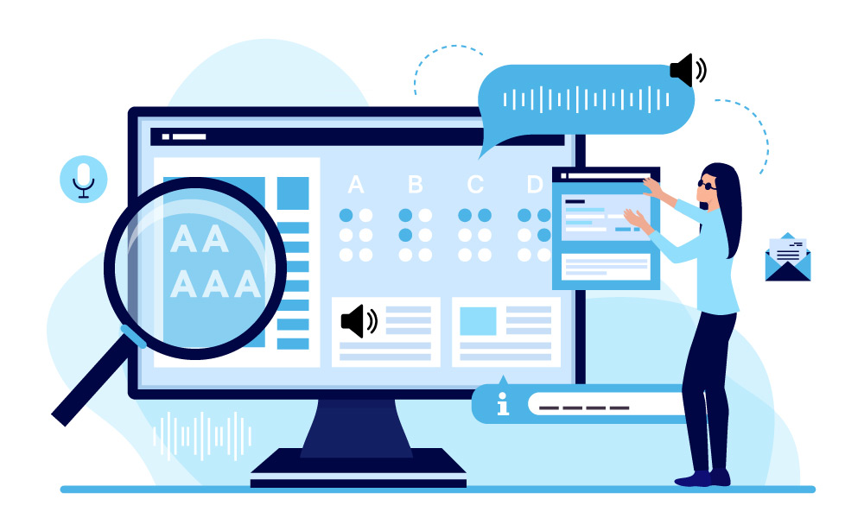
Screen readers (SRs) made much of this information available to visually impaired users. However, since their development, screen readers have offered only limited access to all information on the web page. Often these screen readers either be verbose or skim through information which is biased by accessibility of the website. The handling of SRs comes with numerous and complicated keyboard commands and shortcut keys.

Slide 5
Voice assistants (VAs) work comparatively better than screen readers in terms of interaction. They interact vocally using voice commands and perform tasks based on the keywords identified in the conversation. Existing systems of voice assistants have limited modular features as reading out the contents of the webpages.

Slide 6
Introduction
Despite the widespread prevalence of the World Wide Web, web accessibility remains a pressing concern. This pertains to how users, including those with physical disabilities, access online content. Unfortunately, many websites have been developed without due consideration for these individuals.
Our current project aims to enhance web accessibility for visually impaired individuals, with a specific focus on e-commerce websites. These sites offer extensive opportunities for interaction and present intricate navigation challenges.

Slide 7
Problem statement
Visually impaired individuals struggle with accessing web content due to limitations and complexities of existing screen readers, which often provide either verbose or incomplete information. Additionally, navigating web pages using screen readers requires mastering intricate keyboard commands.
While voice assistants offer a more intuitive interaction method, current systems lack comprehensive features for effectively reading out webpage contents, highlighting the need for a solution that seamlessly bridges the accessibility gap for visually impaired users.

Slide 8
Existing systems
Existing voice assistant systems like Alexa and Siri are limited in their ability to navigate through webpages step by step and primarily focus on retrieving information from websites based on user queries or keywords, rather than comprehensively reading out webpage contents.
This limitation hampers the accessibility of web content for visually impaired individuals who require a more systematic and detailed approach to navigate and interact with online information.

Slide 9
Objectives of the Project
Understand the user’s requirement using voice recognition.
Connect to a cloud server to access world wide web from external hardware device.
Extracting the relevant information from the website.
Analyse the webpage to identify the possible actions that can be performed.
Perform the required task on the webpage automatically.
Build a portable device that can connect to cloud anywhere.

Slide 10

Voice Recognition and Requirement Analysis
We used speech recognition tools for recognizing the user’s voice and converting into text.
The user’s quick and long voice responses can be captured with this.
The quick responses are such as confirmation responses.
The long responses are what the user wants such as queries or to browse items.
The assistant will understand the user requirement using natural language processing.

Slide 11

Analyzing the website
Analyze the website to extract the location of the interactable elements such as:
Input Elements
Navigations elements
Analysis includes the relation between different elements such as parent or sibling for understanding inner details.

Slide 12

Extracting the information
Based on the user query, the assistant extracts the relevant information from the website such as:
Product details
Product ratings
Product reviews
Browsed items data
The information can be voiced out to the user.

Slide 13

Performing tasks on website automatically
Based on the user requirement the assistant can perform the task behalf of user without user involvement such as:
Browsing for item
Filtering the search results
Adding item to cart

Slide 14
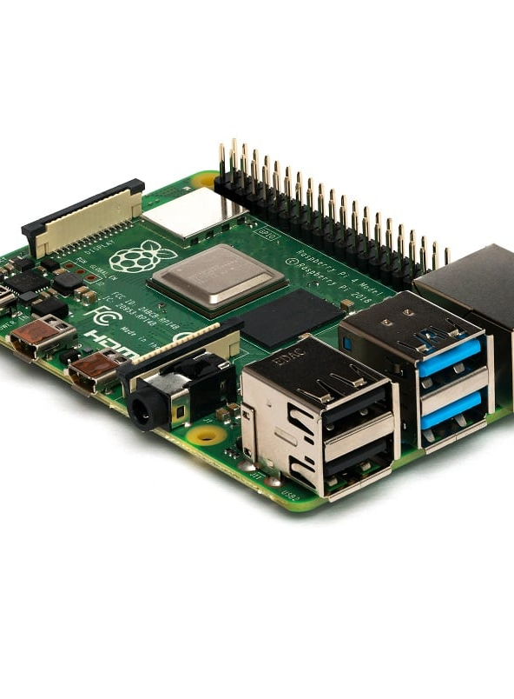
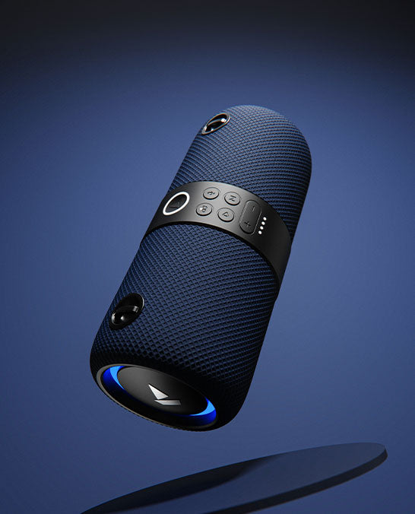
Hardware components
Raspberry Pi
Speakers
Microphone

Slide 15

Challenges faced
Captcha
Sensitive information like:
payments details
credentials

Slide 16

FUTURE SCOPE
Make this assistant available for various websites.
Real time object detection and finding.
Visually impaired user personal assistant for identifying items near them.

Slide 17
THANK YOU
Project Sia Team

